Slide 1
EE-1005 Digital Logic Design
Chapter 1 (Lecture 1)

Slide 2
About Me:
Working as Assistant Professor in EE Dept.
Areas of Interest:
    Digital System Design.
    Internet of Things.
Location:
    Office#108, first floor, B Block
    Email: shehzad.ahmad@nu.edu.pk

Slide 3
Norms of Class:
Class Discipline:
    Never ever miss a class
    Reach the class on time
    Show responsible behavior by not entering or leaving the class after the lecture has started
    Be attentive, don’t distract the teacher by working on assignments of other courses or talking or using mobile phones.
    Don’t attempt to mark proxy attendance
    Strong disciplinary action will be taken in case of serious violation.

Slide 4
Norms of Class:
Departmental Attendace Policy:
    Students are supposed to have 100% attendance in their courses/ labs and the relaxation of 20% attendance has been given only to cover any planned events or unforeseen situations. For Fall-2021, the minimum attendance requirement at all levels and in all courses is 80%.
    Attendance will be taken at the start of lecture/ lab and students are not marked “present” or “late” after 10 minutes of the scheduled start of the lecture i.e. after 10 minutes of the scheduled start of lecture, students are marked absent even if they arrive late (irrespective of reason).
    Leaving the class during the lecture will be considered as absent from class.

Slide 5
Norms of Class:
Questions:
    Raise your hands before asking the questions.
    Should be relevant to the topic of discussion, NOT from the topics which have been discussed in previous lectures or to be discussed in future.

Slide 6
Norms of Class:
Policy about missed assessment items in the course
    Retake of missed assessment items (other than sessional/ final exam) will not be held. Student who misses an assessment item (other than sessional / final exam) is awarded zero marks in that assessment item i.e. late submission will not be accepted.
    For missed sessional/ final exam, exam retake application along with necessary evidence are required to be submitted to the department secretary. The examination assessment and retake committee decides the exam retake cases.

Slide 7
Norms of Class:
Dishonesty:
    All parties involved in any kind of cheating in “Quizzes” will not get zero mark in current assessment but also in next quiz.

Slide 8
Grading Policy
Quizzes : 15%
Mid Exam : 25%
Project : 10%
Final Exam : 50%
Grading Policy: Absolute Grading

Slide 9
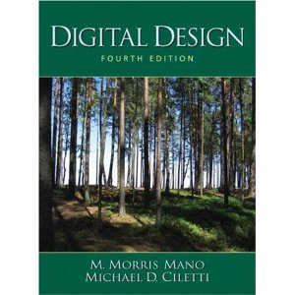
Reading
Text book:
  Digital Design 5th Edition
  M.Morris Mano
    Micheal D.Ciletti

Slide 10

Words of Motivation

Slide 11
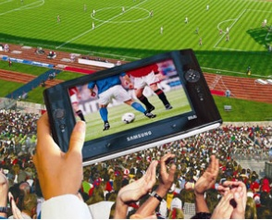
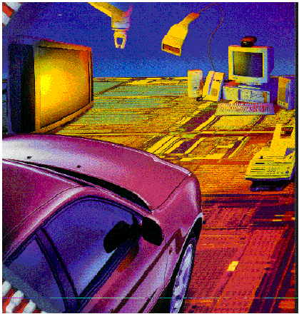
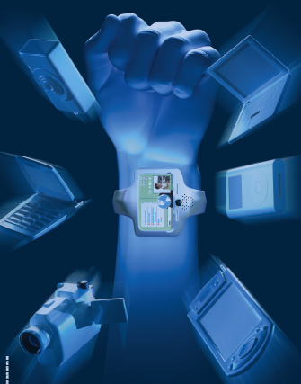
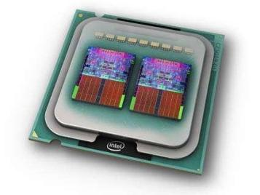
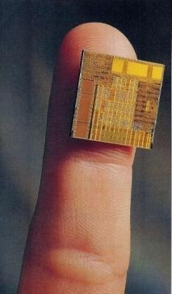
Why Learn DLD?
It‘s a Digital Age
Communications
Multi-media
Manufacturing
Consumer electronics
Health care
Defense and security
Software
Automotive, etc
Notes:
Digital systems are used in communication, business transactions, traffic control, spacecraft guidance, medical treatment, weather monitoring, the Internet, and many other commercial, industrial, and scientific enterprises. We have digital telephones, digital televisions, digital versatile discs, digital cameras, handheld devices, and, of course, digital computers. We enjoy music downloaded to our portable media player (e.g., iPod Touch™) and other handheld devices having high resolution displays. These devices have graphical user interfaces (GUIs), which enable them to execute commands that appear to the user to be simple, but which, in fact, involve precise execution of a sequence of complex internal instructions. Most, if not all, of these devices have a special‐purpose digital computer embedded within them. The most striking property of the digital computer is its generality. It can follow a sequence of instructions, called a program, that operates on given data. The user can specify and change the program or the data according to the specific need. Because of this flexibility, general‐purpose digital computers can perform a variety of information‐processing tasks that range over a wide spectrum of applications.

Slide 12
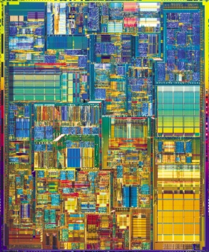
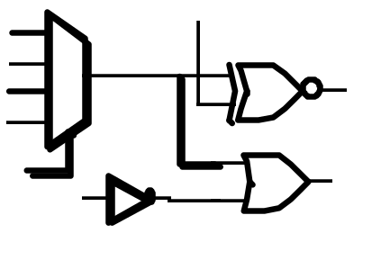

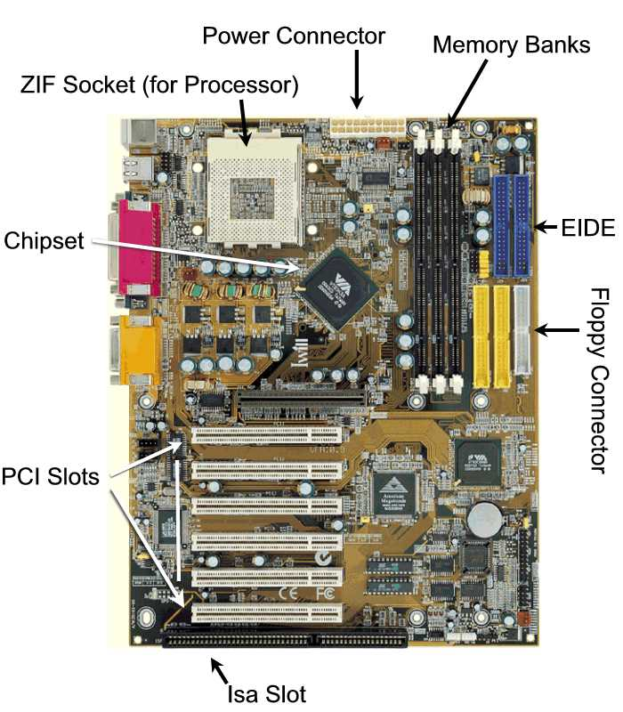
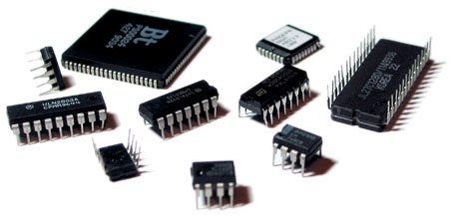
What is DLD?
Deals with building blocks of digital systems
Deals with building blocks of digital systems
?
(Intel)

Slide 13
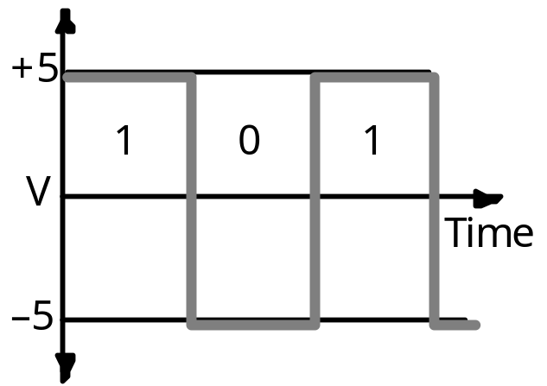
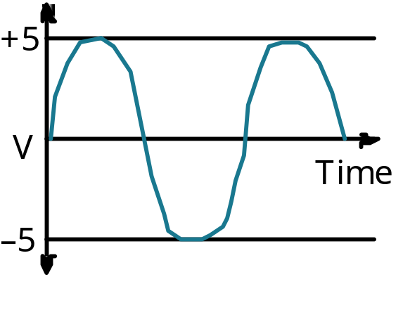
Digital Data V/S Analog Data
Digital:
Take value from finite set of
values
Analog:
Take value in continuous
range

Slide 14
Digital System Advantages
Efficient processing and data storage
Reliable transmission
Easy detection and correction of errors
Easy design and implementation
Occupy minimum space
Programmable
Notes:
Let us have a quick look at the advantages of a Digital System.
Processing and Storage of digital data is efficient.
Computers are very efficient at processing information that is in digital binary form.
A CD can store large number of digitized audio and video clips. Storing same number of audio or video clips in an analogue form requires a large number of audio or video cassettes.
Transmission of digital data is efficient and reliable and less prone to errors.
Even if an error occurs detection and correction of errors in digital data is easier.
We will be looking at a simple example of detecting errors using the parity bit method.
Digitally stored data can be precisely and accurately reproduced.
The picture quality and sound quality of digitized video or audio stored on CDs can be reproduced with a far superior quality as compared to analogue audio and video.
Digital circuits and systems are easier to design and implement.
We would be looking at some simple digital systems in the Digital Logic Design course.
Digital circuits in the form of Integrated circuits occupy very small space.
The PC has a motherboard which has an area less than 1 sq.ft but has all the important circuitry of the computer.
Digital memory implemented as an Integrated circuit small enough to fit in you hand can store an entire collection of books!

Slide 15
Information Processing
Numbers
Text
Formula and Equations
Drawings and Pictures
Sound and Music
Notes:
A computer which is a digital system can process different types of information
It can handle numbers and perform arithmetic operations on the numbers
It can handle text and perform editing operations on text
It can handle mathematical and scientific formulas
It can handle drawings and pictures
It can process sound and music
All this diverse types of information is represented in the form of binary numbers. Different binary standards are used to represent different types of information. For example, text is represented through binary bits, however the bits representing the characters follow a standard ASCII code

Slide 16
Advantages of Digital Systems
Reliable Transmission:
Noise added
Sender
Receiver
Signal
Signal

Slide 17
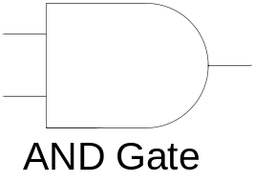
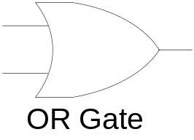
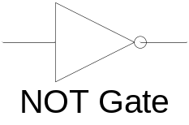
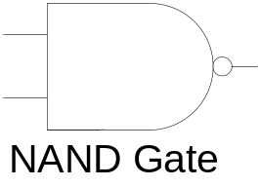
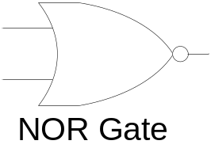
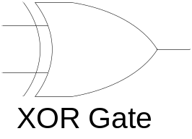
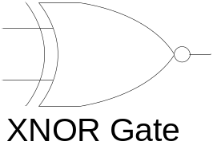

Logic Gate Symbol and ICs
c
3
2
1
0
c
1
1
1
1
9
8
V
7400
D
1
2
3
4
5
6
N
G
Notes:
Each gate is shown to have two inputs except for the NOT gate.
The six gates can have more than two inputs.
All logic gates always have a single output.
The Integrated Circuit shows a NAND Gate IC which has four dual input NAND gates.
Such ICs with different gates are available and used for implementing digital circuits.

Slide 18
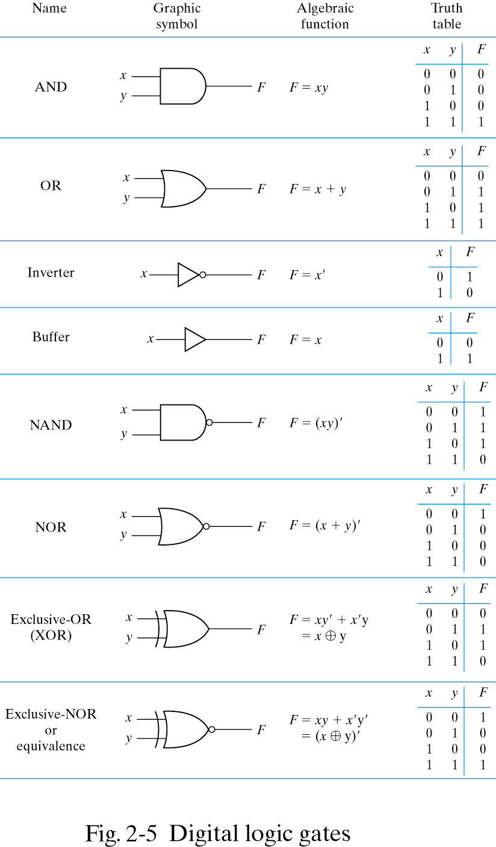
Digital Logic Gates

Slide 19
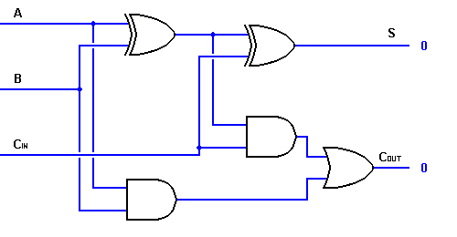
Combinational Circuit

Slide 20
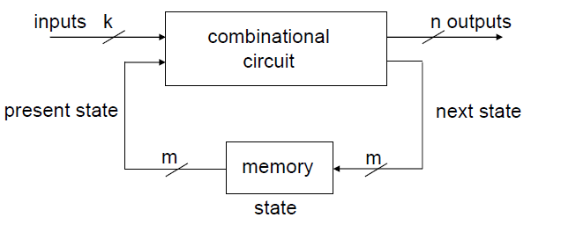
Sequential Circuit

Slide 21
Programmable Logic Devices (PLDs)
Configurable Hardware
Combinational Circuits
Sequential Circuits
Lower Cost
Short development time
Notes:
A modern trend in implementing digital systems is through Programmable Logic Devices or PLDs.
PLDs provide the user with a general purpose circuitry which the user can configure or program to form any combinational or Sequential functional unit.
The adder circuit discussed earlier is a combinational circuit that uses AND, OR and XOR Gates. Thus three different ICs have to be used to implement an adder.
A PLD based implementation only requires a single chip.
The use of PLDs in implementing combinational and sequential circuits results in fewer ICs and thus lower costs. The implementation time is also short.

Slide 22
Memory
Storage
RAM (Random Access Memory)
  Read-Write
  Volatile
ROM (Read-Only Memory)
  Read-Only
  Non-Volatile
Notes:
Memory is an important requirement of a digital system. Besides its use to implement sequential circuits, large memory is required to store information in computer systems. Essentially memory is of two types.
RAM (Random Access Memory) which also stored information to be read or modified.
RAMs are volatile, that is if the power is turned off, the contents stored in the memory are lost.
ROM (Read-Only Memory) as the name specifies allows only read operations. No new information is allowed to be written into the memory.
ROMs are non-volatile and retain the information even if the power is turned off.

Slide 23
Number Systems and Codes
Decimal Number System
Binary Number System
Hexadecimal Number System
Octal Number System
Notes:
Let us start our discussion with Number Systems.
Earlier we have discussed that Digital Systems can process different types of information such as numbers, text, pictures and sound which are represented in the form of Binary numbers.
For understanding the Digital System we need to be fully aware of the Binary Number System and should be able to perform all the functions and operations that we have been performing using the Decimal Number System.
We would be looking at four different Number Systems.
We will start our discussion with the Decimal Number system. We are already aware of the Decimal number system and have been using the decimal number system since our school days.
The third Number System that I would be discussing is the Binary Number System used by digital systems
The last two number systems that I would be mentioning are the Hexadecimal and the Octal Number systems.

Slide 24
Decimal Number System
Ten unique numbers 0,1..9
Base 10
Combination of digits
Positional Number System
275 = 2 x 10² + 7 x 10¹ + 5 x 10⁰
  Base or Radix 10
  Weight 1, 10, 100, 1000 ….
Notes:
The decimal number system has ten unique digits 0, 1, 2, 3… 9
Using these single digits, ten different values can be represented
To represent values greater than ten, the digits have to be used in different combinations. Thus ten is represented by the number 10, two hundred seventy five is represented by 275 etc. Thus same set of numbers 0,1 2… 9 are repeated in a certain order.
The decimal number system is a positional number system as the position of a digit represents its true magnitude. For example 2 is less than 7, however 2 in 275 represents 200, whereas 7 represents 70. The left most digit has the highest weight and the right most digit has the lowest weight.
The weight of subsequent digits increases by a factor of 10 towards the left starting with 1 as the weight of the right most digit or the least significant digit.
275 can be written as 2 x 10² + 7 x 10¹ + 5 x 10⁰ = 200 + 70 + 5 = 275
The 10 represents the base or radix
10², 10¹, 10⁰ represent the weights 100, 10 and 1 of the numbers 2, 7 and 5

Slide 25
Representing Fractions
Fractions can be represented in decimal number system in a similar manner
= 3 x 10² + 8 x 10¹ + 2 x 10⁰ + 9 x 10⁻¹
+ 1 x 10⁻²
= 300 + 80 + 2 + 0.9 + 0.01
= 382.91
Notes:
Fractions can be represented in decimal number system in a manner similar to that of representing integers.
The weight of the digit to the immediate right of the decimal point has a weight 10^{-1.}
Weights of subsequent digits decreases by a factor of 10.
Thus 382.91 can be written in terms of the base number and weights as
3 x 10² + 8 x 10¹ + 2 x 10⁰ + 9 x 10⁻¹ + 1 x 10⁻²
Solving the expression results in five terms 300, 80, 2, 0.9 and 0.01 which sum up to 382.91

Slide 26
Binary Number System
Two unique numbers 0 and 1
Base 2
A binary digit is a bit
Combination of bits to represent larger values
Notes:
Digital systems as mentioned earlier use a Binary number system.
Binary as the name indicates is a base 2 number system having only two values 0 and 1.
A binary digit is known as a Bit.
Similar to other number systems the Binary Number System uses a combination of digits or Bits to represent numbers larger than 0 and 1.
Lets have a look at Binary Representation of Decimal Numbers.

Slide 27
Binary to Decimal Conversion
Sum of Weights
Combination of Bits
10011₂ = 19₁₀
= (1 x 2⁴) + (0 x 2³) + (0 x 2²) + (1 x 2¹)
+ (1 x 2⁰)
= (1 x 16) + (0 x 8) + (0 x 4) + (1 x 2)
+ (1 x 1)
= 16 + 0 + 0 + 2 + 1
= 19
Notes:
Don’t worry, if you have not understood the binary representation. We would be discussing binary numbers through the course.
Let us find out what does the Binary combination 10011₂ represent? It represents the decimal number 19.
Let us see how the Binary number 10011₂ represent decimal 19?
The decimal equivalent of a combination of binary number can easily be found by writing an expression in terms of the base value and weights as we did earlier with the caveman number system.
What is the base number of binary number system? 2
What are the weights of the 5 bits 10011? Starting from the most significant left most bit the weights are 2⁴, 2³, 2², 2¹ and 2⁰.
Writing an expression in terms of the binary bits and the respective weights results in the expression (1 x 2⁴) + (0 x 2³) + (0 x 2²) + (1 x 2¹) + (1 x 2⁰)
Solving the expression results in five terms 16, 0, 0, 2 and 1, which sum up to 19.
The subscript 2 indicates that the number 10011 is binary and not decimal ten thousand eleven.
The weights of the 5 bits starting from the left, most significant bit are 16, 8, 4, 2 and 1.
The weights in a Binary Number system change by a factor of two.
The most significant bit on the extreme left has the highest weight.
In the decimal number and the caveman number system the weights increased by a factor of 10 and 5 respectively.

Slide 28
Binary Number System
Decimal Number | Binary Number | Decimal Number | Binary Number
0 | 0 | 10 | 1010
1 | 1 | 11 | 1011
2 | 10 | 12 | 1100
3 | 11 | 13 | 1101
4 | 100 | 14 | 1110
5 | 101 | 15 | 1111
6 | 110 | 16 | 10000
7 | 111 | 17 | 10001
8 | 1000 | 18 | 10010
9 | 1001 | 19 | 10011
Notes:
A single binary bit can represent only two decimal values 0 and 1.
To represent the next two decimal values, two binary bits are used. The most significant bit remains fixed at 1 and the least significant bit changes between 0 and 1. Thus decimal numbers 2 and 3 are represented by two bit binary numbers 10 and 11 respectively.
How are the decimal numbers 4 and 5 represented?
The decimal numbers 4 and 5 are represented by a combination of 3 bits. The most significant two bits remain fixed and the least significant bit changes between 0 and 1.
Higher decimal numbers can be represented in binary by using a larger combination of bits.
The Binary representations of the first 20 decimal numbers are shown in the table.

Slide 29
Fractions in Binary
Fractions in Binary
1011.101₂ = 11.625
  = (1 x 2³) + (0 x 2²) + (1 x 2¹) + (1 x 2⁰)
  + (1 x 2⁻¹) + (0 x 2⁻²) + (1 x 2⁻³)
  = (1 x 8) + (0 x 4) + (1 x 2) + (1 x 1)
  + (1 x 1/2) + (0 x 1/4) + (1 x 1/8)
  = 8 + 0 + 2 + 1 + 0.5 + 0 + 0.125
  = 11.625
Floating Point Notations
Notes:
Both integers and fractions can be represented in the Binary number system just like in the decimal number system.
The number 1011.101₂ is equivalent to decimal 11.625
Let us see how?
Calculating the decimal equivalent of a binary number representing a fraction can easily be done by writing the expression in terms of the base value and weights as was done in the case of integer numbers.
The binary number 1011.101₂ has an integer part 1011 having the weights 2³, 2², 2¹ and 2⁰.
The fraction part 101 has the weights 2⁻¹, 2⁻² and 2⁻³.
The weights of the fraction part of the binary number decrease by a factor of 2 starting from the bit immediately to the right of the decimal point.
(1 x 2³) + (0 x 2²) + (1 x 2¹) + (1 x 2⁰) + (1 x 2⁻¹) + (0 x 2⁻²) + (1 x 2⁻³)
Multiplying the weights with the corresponding decimal equivalents of the binary bits results in the terms 8, 0, 2, 1, 0.5, 0 and 0.125 which add up to give 11.625
One last word on binary representation of fractions. Computers do handle numbers such as 11.625 that have an integer part and a fraction part. However, it does not use the binary representation 1011.101. Such numbers are represented and used in Floating-Point Numbers notation which will be discussed latter

Slide 30
Binary to Decimal Conversion
Add weights of non-zero terms
Weights increase/decrease by power of 2
10011₂ = 16 + 2 + 1 = 19
1011.101₂ = 8 + 2 + 1 + 1/2 + 1/8
= 11 + 5/8
= 11.625
Notes:
A quicker method is to add the weights of non-zero terms.
What are the weights of the non-zero terms for the binary number 10011₂?
If you remember the weight of the binary bits increase by a factor of two starting from the least significant bit.
Thus the weights of non-zero terms are 16, 2 and 1. Adding the weights of non-zero terms results in 19.
Adding the weights of non-zero terms involves mental arithmetic and is quick way of converting binary numbers into decimal.
Consider another example of converting 1011.101₂ to decimal using sum of non-zero terms.
The weights of the non-zero terms are 8, 2, 1, ½ and 1/8 which add up to 11.625.
You should practice the adding of non-zero terms to find decimal equivalents of binary numbers as it is a convenient and quick way to convert binary into decimal.

Slide 31
Decimal-Binary Conversion
Binary to Decimal Conversion
  Sum-of-Weights
  Adding weights of non-zero terms
Decimal to Binary Conversion
  Repeated Division by 2
Notes:
The Decimal number system is used to represent and handle numbers in the Real world.
On the other hand the Binary number system is used in the digital world.
We should be able to convert from decimal to binary and vice versa.
To convert from Binary to Decimal the Sum-of-Weights method is used, as we have been doing.
A second quicker method is to add weights of only the non-zero terms
Converting from Decimal to Binary is done by using the Sum-of-Weights method in reverse.
The other method used is the repeated division by 2.

Slide 32
Decimal to Binary Conversion
number | Quotient after division | Remainder after division
392 | 196 | 0 (b₀)
196 | 98 | 0 (b₁)
98 | 49 | 0 (b₂)
49 | 24 | 1 (b₃)
24 | 12 | 0 (b₄)
12 | 6 | 0 (b₅)
6 | 3 | 0 (b₆)
3 | 1 | 1 (b₇)
1 | 0 | 1 (b₈)
Notes:
Repeated Division-by-2 method allows decimal numbers of any magnitude to be converted into binary.
The original number is divided by 2, its quotient and the remainder is noted.
The quotient obtained in the first step is again divided and the new quotient and remainder value noted.
The process of repeatedly dividing the previous quotient value and noting the remainder continues until the quotient value becomes 0.
The remainders noted in the repeated division are written out in reverse to represent the binary equivalent of the decimal number.
110001000

Slide 33
Decimal-Binary fraction conversion
Decimal to Binary Conversion
  Repeated multiplication by 2
Number | Mult. By 2 | Integer
0.8125 | 1.625 | 1 (b₋₁)
0.625 | 1.250 | 1 (b₋₂)
0.250 | 0.500 | 0 (b₋₃)
0.500 | 1.000 | 1 (b₋₄)
Notes:
Converting fractions from decimal to binary requires repeated multiplication by 2.
The decimal number 0.8125 to be converted into binary is multiplied by 2 which results in 1.625.
The integer part ‘1’ is noted and the fraction part is multiplied by 2. The result is 1.250.
The integer part ‘1’ is noted and the fraction part is multiplied by 2. The result is 0.5.
The integer part ‘0’ is noted and the fraction part is multiplied by 2. The result is 1.
Since the fraction part is 0, therefore there is no further need for multiplying with 2.
The integer part is noted and the noted integer values are written out preceded by a decimal point to give 0.1101

Slide 34

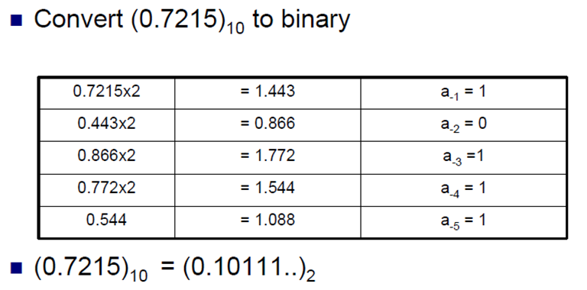
Decimal-Binary fraction conversion

